Slide 1

Evaluating Cognitive Analytics in Aircraft Maintenance
A Case Study on Honeywell Aerospace
MARKETING
ANALYTICS
PRESENTATION
BBA-BUSINESS ANALYTICS
UNDER THE SUPERVISION OF :
Dr. PALAK GUPTA
BY : KUSHAGRA TAMANG

Slide 2


COMPANY
OVERVIEW
Honeywell Aerospace is one of the world’s leading aerospace technology and manufacturing companies, headquartered in Phoenix, Arizonag
The company provides a wide range of aerospace products and services including:
Aircraft engines
Navigation systems
Cockpit displays
Communication systems
Maintenance and repair solutions
The company focuses on improving aircraft safety, operational efficiency, and maintenance performance through advanced technologies and data-driven solutions.
Honeywell Aerospace is increasingly investing in:
Artificial Intelligence (AI)
Cognitive Analytics
Predictive Maintenance
Cloud-based maintenance systems
The company aims to reduce aircraft downtime, improve fault diagnosis, and provide faster and more reliable maintenance support to customers worldwide.
Honeywell Aerospace serves:
Airlines
Aircraft manufacturers
Airports
Defense organizations
Space contractors

Slide 3
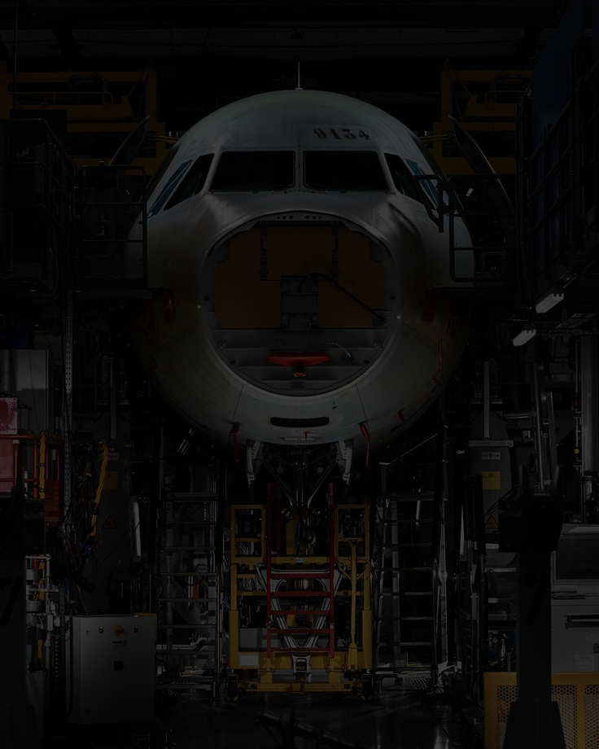
EXISTING MAINTENANCE PROCESS
Current Aircraft Maintenance Workflow
1. Fault Occurs in Aircraft: Aircraft systems generate fault codes when technical issues are detected.
2. Fault Codes Are Reported: Fault codes are transmitted automatically or reported by pilots to ground technicians
3. Manual Search Process:- Technicians search multiple:
maintenance manuals
repair documents
databases
service bulletins
4. Troubleshooting & Diagnosis: Technicians try to identify the root cause of the problem under high time pressure.
5. Repair & Part Replacement: Parts are repaired or replaced to restore aircraft operations.
6.Aircraft Returns to Service: After troubleshooting and repairs are completed, the aircraft becomes operational again
Major Problems in Existing Process
Fragmented information systems
Slow troubleshooting process
High aircraft downtime
Manual dependency
Inefficient fault diagnosis
Increased maintenance costs
Main Limitation
The current maintenance system is mostly:
Reactive
meaning problems are solved after failures occur, rather than predicting issues in advance.

Slide 4
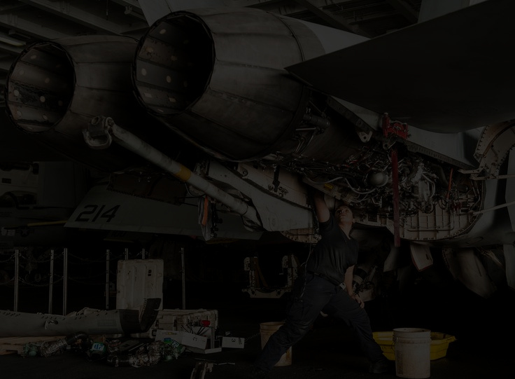
PROBLEM IDENTIFICATION
AIRCRAFT MAINTENANCE AT HONEYWELL AEROSPACE IS HIGHLY COMPLEX DUE TO THE LARGE VOLUME OF AIRCRAFT PARTS, FAULT CODES, AND MAINTENANCE DATA.
Technicians often face difficulties in:
Quickly diagnosing faults
Accessing maintenance information
Identifying the root cause of failures
Maintenance information is fragmented across multiple systems, manuals, and databases, making troubleshooting slow and inefficient.
Due to time pressure, technicians often use “Shotgun Maintenance,” in which multiple parts are replaced without accurately identifying the problem.
Major operational challenges include:
Aircraft downtime
Delayed fault diagnosis
Inefficient troubleshooting
Increased maintenance costs
Poor customer experience
These operational inefficiencies can negatively affect:
Customer satisfaction
Customer loyalty
Long-term customer retention
Therefore, Honeywell Aerospace needs a smarter, AI-driven, and predictive maintenance system to improve maintenance efficiency, reduce downtime, and enhance customer experience

Slide 5

COGNITIVE ANALYTICS
Cognitive Analytics uses Artificial Intelligence (AI), Machine Learning, Natural Language Processing (NLP), and data analytics to simulate human thinking and improve decision-making.
In aircraft maintenance, cognitive analytics helps technicians:
analyse large amounts of maintenance data
identify fault patterns
access solutions quickly
improve troubleshooting accuracy
Main Objective
Transform traditional aircraft maintenance into a: Smart, Proactive, and Data-Driven Maintenance System.
Technologies Used
Artificial Intelligence (AI)
Machine Learning
Natural Language Processing (NLP)
Internet of Things (IoT)
Cloud Computing
Predictive Maintenance Systems
Business Benefits
Reduced maintenance delays
Improved operational efficiency
Lower repair costs
Better customer experience
Increased aircraft reliability
Improved customer satisfaction

Slide 6

STRATEGIC OPTIONS CONSIDERED
Option 1 — Internal Model-Based System
Develop an in-house aircraft maintenance platform.
Expand Honeywell’s existing onboard maintenance system.
Use internal resources and engineering expertise.
Advantages
✅ Strong internal support
✅ Trusted technology
✅ Better control
Challenges
❌ High development time
❌ Expensive implementation
Option 2 — IBM Watson Partnership
Use IBM Watson’s cognitive analytics and AI capabilities.
Build an AI-powered maintenance support system using natural language processing and machine learning.
Advantages
✅ Advanced AI technology
✅ Strong brand reputation
✅ Powerful predictive analytics capabilities
Challenges
❌ Complex implementation process
❌ Requires extensive data training
❌ High resource and time requirements
Option 3 — SparkCognition Partnership
Partner with SparkCognition, an AI startup specializing in cognitive analytics solutions.
Advantages
✅ Faster implementation
✅ Lower development time/ Simplified AI integration
✅ Better flexibility
Challenges
❌ Startup risk
❌ Limited industry track record
❌ Less proven than IBM Watson

Slide 7
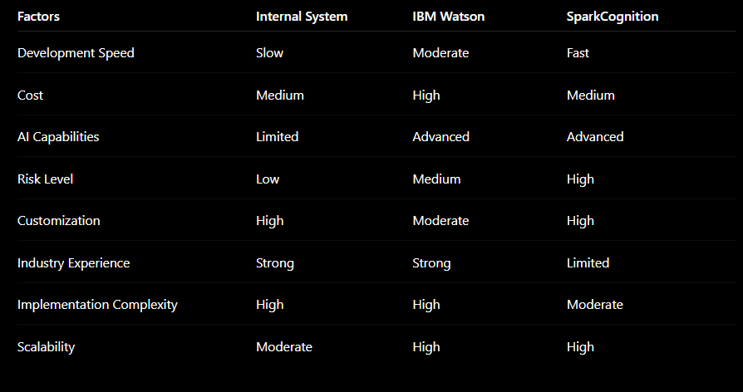
IBM WATSON VS SPARKCOGNITION VS INTERNAL SYSTEM

Slide 8
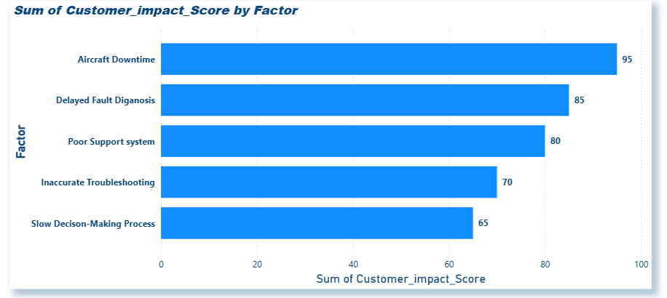
MARKETING ANALYTICS CONCEPTS
1. CUSTOMER CHURN ANALYSIS
CUSTOMER CHURN REFERS TO THE LOSS OF CUSTOMERS DUE TO DISSATISFACTION, POOR SERVICE QUALITY, OR BETTER ALTERNATIVES AVAILABLE IN THE MARKET.
“Major Causes of Customer Dissatisfaction”
Variables:
Aircraft Downtime
Delayed Fault Diagnosis
Poor Support Systems
Inaccurate Troubleshooting
Slow Decision-Making
Interpretation
The chart indicates that aircraft downtime and delayed fault diagnosis are the major contributors to customer dissatisfaction. Operational inefficiencies in maintenance services negatively affect customer experience and increase the risk of customer churn. Improving troubleshooting speed and maintenance accuracy can help strengthen customer retention.

Slide 9
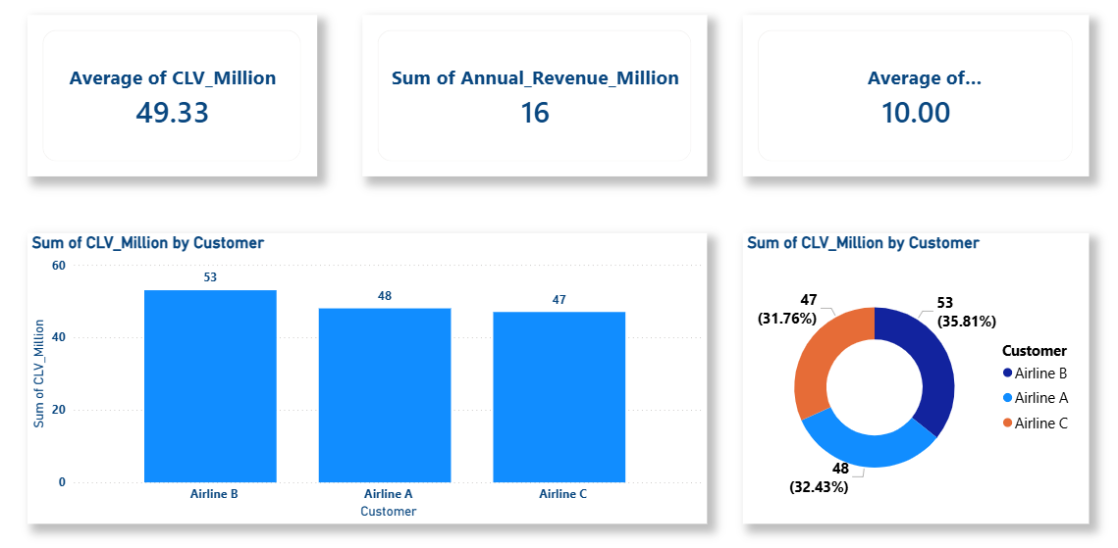
2. CUSTOMER LIFETIME VALUE (CLV)
CUSTOMER LIFETIME VALUE (CLV) REFERS TO THE TOTAL REVENUE GENERATED BY A CUSTOMER THROUGHOUT THEIR RELATIONSHIP WITH A COMPANY.
“Customer Lifetime Value of Airline Customers”
Variables:
Airline A
Airline B
Airline C
Interpretation
The chart shows that airline customers contribute significant long-term value to Honeywell Aerospace through maintenance contracts and service agreements. Retaining high-value customers is important for improving profitability and long-term business growth.

Slide 10
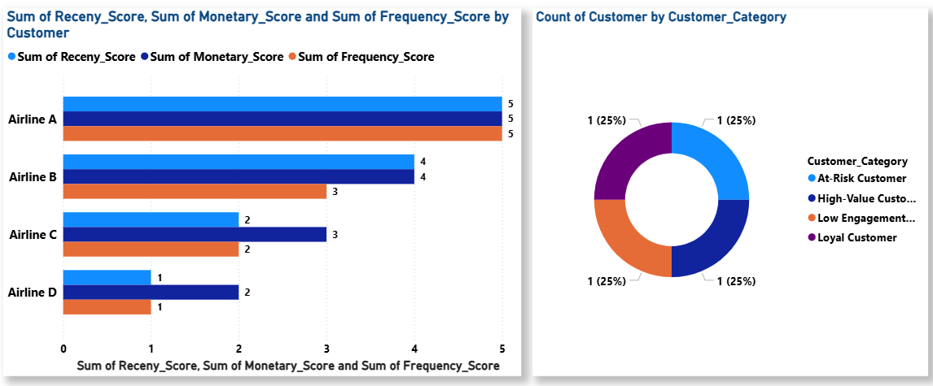
3. RFM ANALYSIS
RFM ANALYSIS IS A CUSTOMER ANALYTICS TECHNIQUE USED TO IDENTIFY VALUABLE CUSTOMERS BASED ON:
RECENCY
FREQUENCY
MONETARY VALUE
“RFM Scores of Airline Customers”
Variables:
Recency
Frequency
Monetary Scores
Interpretation
The chart highlights differences in customer engagement and value. High-value customers with strong RFM scores should receive personalized support and premium maintenance services to improve loyalty and retention.

Slide 11
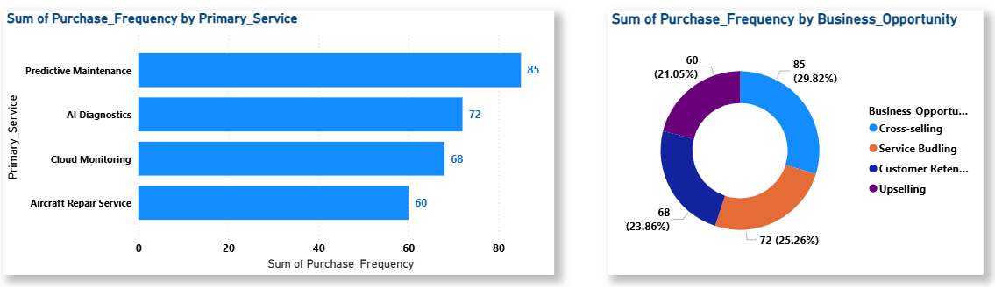
4. PREDICTIVE MAINTENANCE KPI
PREDICTIVE MAINTENANCE USES AI, MACHINE LEARNING, AND REAL-TIME SENSOR DATA TO IDENTIFY EQUIPMENT FAILURES BEFORE THEY OCCUR.
“Impact of Predictive Analytics on Maintenance Performance”
Variables:
Downtime
Repair Time
Maintenance Cost
Customer Satisfaction
Interpretation
The chart demonstrates that predictive analytics can significantly reduce aircraft downtime, lower maintenance costs, and improve customer satisfaction by enabling proactive maintenance and faster troubleshooting.

Slide 12
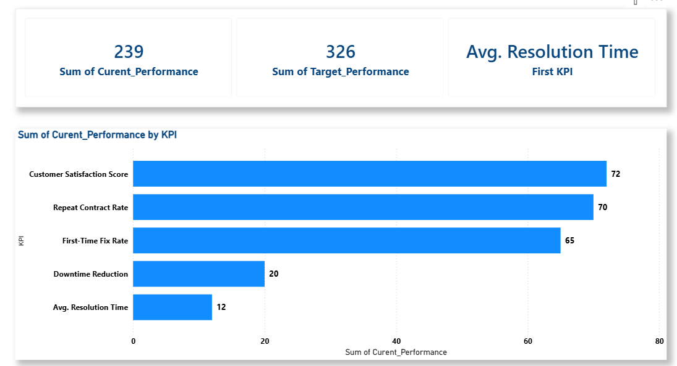
5. CUSTOMER EXPERIENCE KPI FRAMEWORK
CUSTOMER EXPERIENCE KPIS ARE PERFORMANCE METRICS USED TO MEASURE CUSTOMER SATISFACTION, SERVICE QUALITY, AND OPERATIONAL EFFICIENCY.
“Current vs Target KPI Performance”
KPIs:
CSAT
Resolution Time
First-Time Fix Rate
Downtime Reduction
Interpretation
The KPI dashboard highlights the gap between current and target performance levels. Improving maintenance response time, troubleshooting accuracy, and downtime reduction can significantly enhance customer satisfaction and operational efficiency.

Slide 13
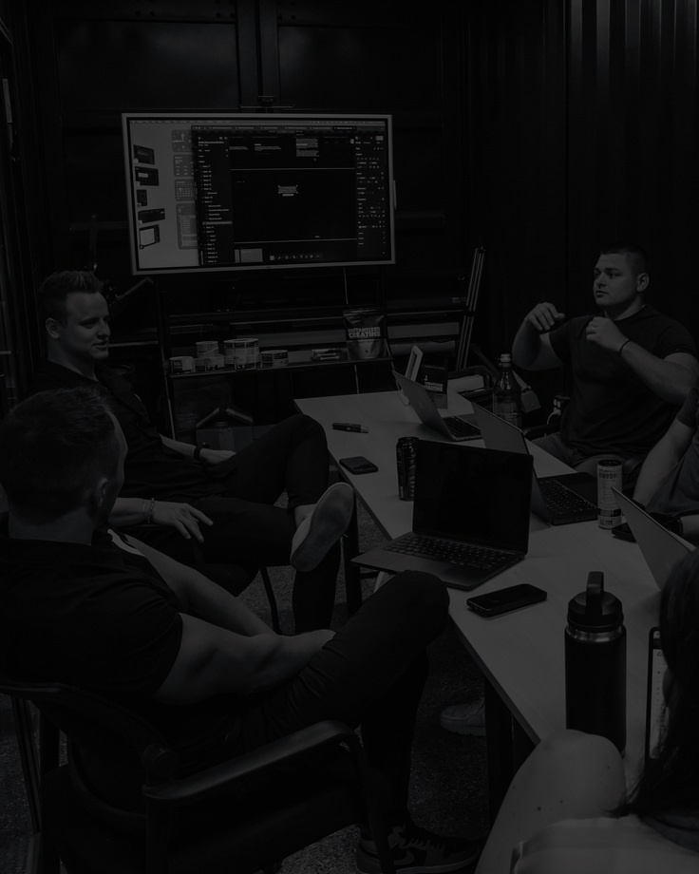
STRATEGIC RECOMMENDATIONS
1. Implement AI-Powered Predictive Maintenance Systems
Use AI and predictive analytics to detect failures before they occur.
Reduce aircraft downtime and improve maintenance accuracy.
Benefits
Faster fault detection
Lower maintenance costs
Improved operational efficiency
2. Develop a Cloud-Based Maintenance Platform
Create a centralized digital platform for technicians to access:
maintenance manuals
troubleshooting data
service bulletins
real-time analytics
Benefits
Faster troubleshooting
Better information access
Improved global coordination
3. Strengthen Customer Retention Programs
Introduce:
premium maintenance contracts
personalized support services
priority technical assistance
Benefits
Improved customer loyalty
Higher contract renewals
Increased Customer Lifetime Value (CLV)
4. Build a Technician Knowledge-Sharing Platform
Enable technicians to share:
repair experiences
troubleshooting solutions
best practices
Benefits
Faster issue resolution
Better collaboration
Improved maintenance efficiency

Slide 14
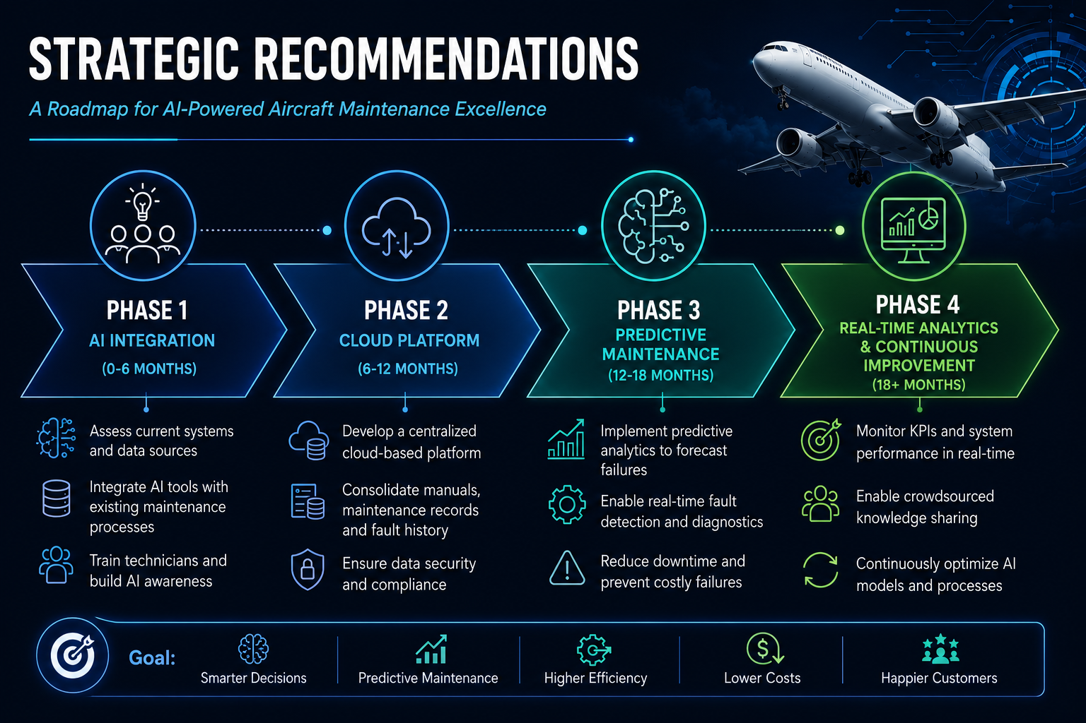

Slide 15
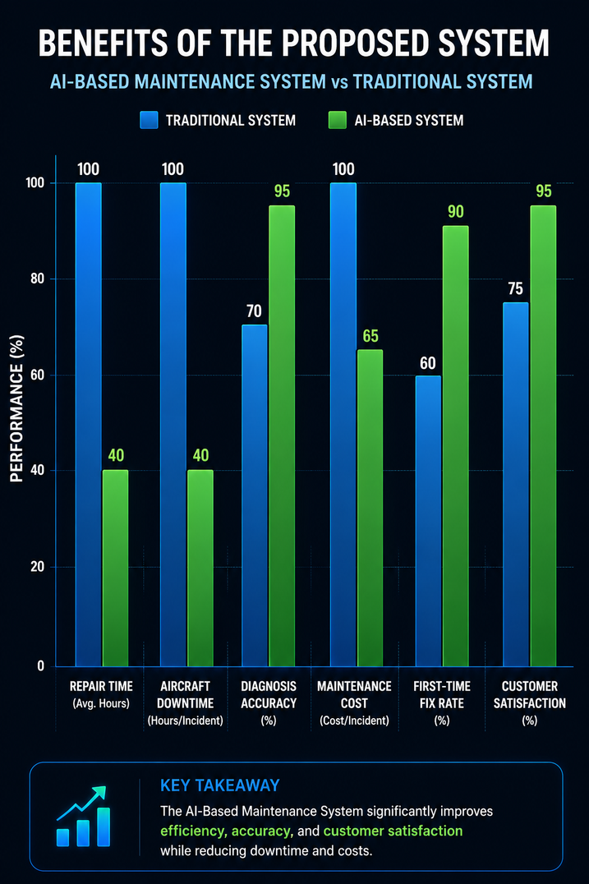
BENEFITS OF THE PROPOSED SYSTEM
Faster identification and resolution of aircraft maintenance issues.
Reduced aircraft downtime and operational delays.
Improved accuracy in fault diagnosis and repair processes.
Decrease in unnecessary part replacements and maintenance costs.
Enhanced technician productivity through AI-powered support systems.
Real-time access to maintenance data and troubleshooting solutions.
Better predictive maintenance capabilities to prevent future failures.
Improved customer satisfaction through reliable and efficient service.
Increased operational efficiency and long-term cost optimization.
Stronger competitive advantage through advanced AI-driven technologies.

Slide 16

THANK YOU

